Slide 1


Fundamentals of RM
RM System and Process
Leadership in RM
Incident Investigation
RM Tools & Challenges
RM in Industry
People & Org.
Application and Perspectives
On Becoming a
Leader in Risk Management
ENGG404 - Lecture
Chapter 4.2: Cause and Effect Model for Incident Analysis
Chapter 4.3: Root Cause Analysis of an Incident
- Latent Causes -

Slide 2
Learning Outcomes:
This topic:
Builds on Topic #19 Chapter 4.2: Cause and Effect Model for Incident Analysis and Chapter 4.3: Root Cause Analysis of an Incident - Fundamentals
Examines the latent causes as discovered in a Root Cause Analysis;
Learning Outcomes:
Develop a thorough, comprehensive, and logical RCA Chart.
Explain the parts of and write an acceptable statement of a latent cause in an RCA.
Link a latent cause to a management system element.
Set the stage with a well-written, acceptable latent cause statement in order to create a recommendation to address that latent cause.
Chapter 4.2: C&E Model & Chapter 4.3: RCA of an Incident
2
Notes:
2

Slide 3
Latent Causes – The What and Why:
Latent causes are weaknesses in the elements of the Risk Management System.
They are NOT:
Risk Management System Elements
Management failures i.e. “management failed to …”
See “Factors often missed or completed incorrectly for the RCA chart” in the Team Project Instruction Manual
When identified, the latent causes:
Relate to the elements of the management system
Reflect inadequacies in the management system and program
Are stated in unique terms specific to the root in the RCA for that loss incident.
Thus, meaningful management action and management control can be undertaken to address a latent cause.
Leaders must drive the root cause analysis process to effectively find the Latent Causes.
Chapter 4.2: C&E Model & Chapter 4.3: RCA of an Incident
3
Notes:
3

Slide 4
Practice – Latent Causes:
Let’s redraw the RCA and focus on three basic causes to discover the root causes on the RCA!
Mining LI: “You are called to a scene where a mining haul truck and a shovel have been crushed with debris from an adjacent slope. You find one individual with a severe injury. You know the slopes are being monitored, you know there are procedures for safe work near the slopes, you know it had been raining for the last week.”
Chapter 4.2: C&E Model & Chapter 4.3: RCA of an Incident
4
Notes:
4
This is meant to drive class discussion

Slide 5
Drilling Down to Latent Causes in the RCA:
Debris fell on equipment, injuring one Worker & damaged equipment
Let’s redraw the RCA and focus on three basic causes to discover the root causes on the RCA!
Equipment & Worker Were In Exclusion Zone
Worker did not follow exclusion zone procedures
Worker was not aware of exclusion zone procedures
Worker disregarded exclusion zone procedures
Supervisor told Worker to go into the exclusion zone
Chapter 4.2: C&E Model & Chapter 4.3: RCA of an Incident
5
Notes:
5

Slide 6
ALE #1: State a Latent Causes in the RCA:
Debris fell on equipment, injuring one Worker & damaged equipment
Equipment & Worker Were In Exclusion Zone
Please confer and select an appropriate latent cause statement for the indicated basic cause (MM-Poll):
Worker did not follow exclusion zone procedures
Worker was not aware of exclusion zone procedures
Worker disregarded exclusion zone procedures
Supervisor told Worker to go into the exclusion zone
Chapter 4.2: C&E Model & Chapter 4.3: RCA of an Incident
6
Notes:
6

Slide 7
Drilling Down to Latent Causes in the RCA:
Debris fell on equipment, injuring one Worker & damaged equipment
Equipment & Worker Were In Exclusion Zone
Worker did not follow exclusion zone procedures
Basic Cause?
Does this
make sense?
Is there a
logic leap?
Worker was not aware of exclusion zone procedures
Worker disregarded exclusion zone procedures
Supervisor told Worker to go into the exclusion zone
LC1: There was no training program for mining operations.
Chapter 4.2: C&E Model & Chapter 4.3: RCA of an Incident
7
Notes:
7

Slide 8
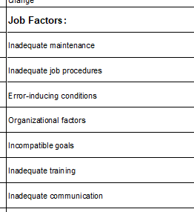
Drilling Down to Latent Causes in the RCA:
Debris fell on equipment, injuring one Worker & damaged equipment
Equipment & Worker Were In Exclusion Zone
Worker did not follow exclusion zone procedures
Intermediate Cause
Worker was not aware of exclusion zone procedures
Worker disregarded exclusion zone procedures
Supervisor told Worker to go into the exclusion zone
Basic Cause
Worker was not trained on those procedures
Use the C&E Model to determine cause-category:
Latent Cause
LC1: There was no training program for mining operations.
BC sub-sub-category
Chapter 4.2: C&E Model & Chapter 4.3: RCA of an Incident
8
Notes:
8

Slide 9
Drilling Down to Latent Causes in the RCA:
Worker did not follow exclusion zone procedures
Worker was not aware of exclusion zone procedures
Worker disregarded exclusion zone procedures
Supervisor told Worker to go into the exclusion zone
Immediate Cause
Basic Cause
B-JF: Procedures were not enforced through audits
LC2: The evaluation program did not include the exclusion zone procedures on the auditing schedule.
Latent Cause
Chapter 4.2: C&E Model & Chapter 4.3: RCA of an Incident
9
Notes:
9

Slide 10
Drilling Down to Latent Causes in the RCA:
Worker did not follow exclusion zone procedures
Worker was not aware of exclusion zone procedures
Worker disregarded exclusion zone procedures
Is this an acceptable statement
for a latent cause?
Supervisor told Worker to go into the exclusion zone
Basic Cause
B-JF: Supervisor prioritized production over safety
Latent Cause?
Supervisor believed that production was paramount over safety
Chapter 4.2: C&E Model & Chapter 4.3: RCA of an Incident
10
Notes:
10

Slide 11
Drilling Down to Latent Causes in the RCA:
Worker did not follow exclusion zone procedures
Worker was not aware of exclusion zone procedures
Worker disregarded exclusion zone procedures
Does this
make sense?
Supervisor told Worker to go into the exclusion zone
Basic Cause
B-JF: Supervisor prioritized production over safety
Intermediate
Supervisor believed that production was paramount over safety
Latent Cause
LC3: Core Safety Values Communications Program was not implemented **
Chapter 4.2: C&E Model & Chapter 4.3: RCA of an Incident
11
Notes:
11

Slide 12
Drilling Down to Latent Causes in the RCA:
Worker did not follow exclusion zone procedures
Worker was not aware of exclusion zone procedures
Worker disregarded exclusion zone procedures
Supervisor told Worker to go into the exclusion zone
Basic Cause
B-JF: Supervisor prioritized production over safety
Intermediate
Supervisor believed that production was paramount over safety
Intermediate
Sr Mngmt expectations were not in alignment with core safety values
Latent Cause
LC3: Core Safety Values Communications Program was not implemented **
** Is this an acceptable latent cause statement? We will revisit this!
Chapter 4.2: C&E Model & Chapter 4.3: RCA of an Incident
12
Notes:
12

Slide 13
Basic Causes
Debris fell, injuring one Worker & damaged equipment
Equipment & Worker Were In Exclusion Zone
The RCA Chart
is developed!
Latent Causes
Worker did not follow exclusion zone procedures
Worker was not aware of exclusion zone procedures
BC-JF: Worker disregarded exclusion zone procedures
Supervisor told Worker to go into the exclusion zone
BC-PF: Supervisor prioritized production over safety
Improvements! Creating an RCA Chart is an iterative and collaborative activity!
Supervisor believed that production was paramount over safety
BC-JF: Worker was not trained on those procedures
BC-JF: Procedures were not enforced through audits
Sr Mngmt expectations were not in alignment with core safety values
LC2: The evaluation program did not include the exclusion zone procedures on the audit schedule.
LC1: There was no training program for mining operations.
LC3: Core Safety Values Communications Program was not implemented. **
RME #9 ECT
RME #6 PECI
RME #1 MLCA
Chapter 4.2: C&E Model & Chapter 4.3: RCA of an Incident
13
Notes:
13

Slide 14

Latent Causes and the Risk Management System Elements:
Categories of Latent Causes:
P = Inadequate Program
S = Inadequate Standards
(Standard = administrative control)
C = Inadequate Compliance
Chapter 4.2: C&E Model & Chapter 4.3: RCA of an Incident
14
Notes:
14

Slide 15
Explanation of LC Categories and Hints on Latent Causes:
[P] Inadequate Program:
The overall RM Program (policy or high-level direction) and RMS Element that relate to that particular latent cause are non-existent for or lacking in large part.
[S] Inadequate Standards (of the program):
Program exists but supporting administrative controls are non-existent or inadequate for that particular root of analysis
The administrative controls (policies, procedures, checklists, schedules) document in detail the tasks / instructions and roles / responsibilities for undertaking activities and managing the risks of those activities.
[C] Inadequate Compliance (with program standards):
Program and supporting documentation exist, but the work practices (the actual execution of the work) do not comply with the requirements as specified in the standard i.e. not being done or not being done correctly.
HINT: Because the categories of latent causes are inadequate program, inadequate program standards, and inadequate compliance with program standards, then the latent cause must be expressed in similar terms.
Chapter 4.2: C&E Model & Chapter 4.3: RCA of an Incident
15
Notes:
15

Slide 16
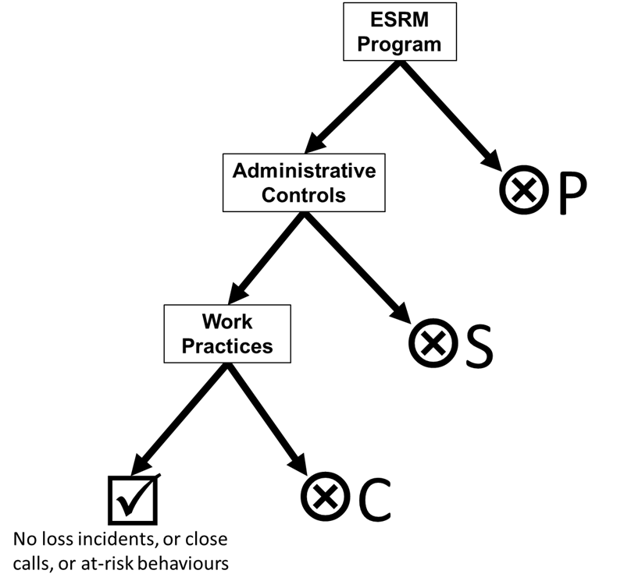
Categories for Latent Causes – P, S, and C:
Which Category – P, S, or C?
Can the P, S, or C category for a latent cause be determined in an RCA?
Yes – if you have sufficient information which
will likely be the case in the workplace when
you investigate, lead an RCA, etc.
No – in absence of information i.e. team project:
    You will not have sufficient information to
    discern P, S, or C.
    Use your engineering know-how, your
    expertise in risk management, and
    knowledge of the incident to make reasonable suppositions.
    The manner in which you state your latent cause may reveal whether it is P, S, or C.
    Per the section “b) The Project Perspective, Context, etc.” in the Team Project Instruction Manual, it should likely be a “S” category.
Chapter 4.2: C&E Model & Chapter 4.3: RCA of an Incident
16
Notes:
16

Slide 17

Example Model for the Set of Categories of Latent Causes:
Large grey arrow is
the desired path …
but may deviate!
Chapter 4.2: C&E Model & Chapter 4.3: RCA of an Incident
17
Notes:
17

Slide 18
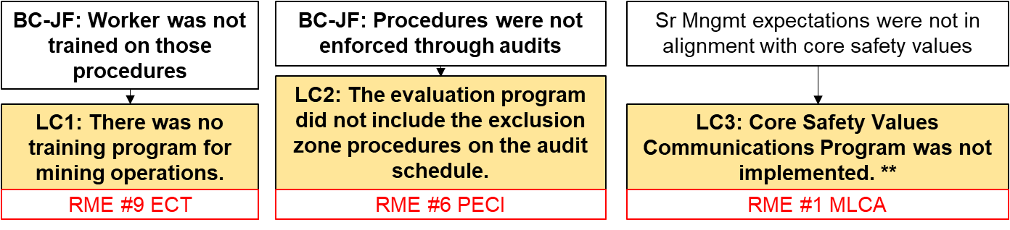
Example Model for the Set of Categories of Latent Causes:
Apply this concept to our mining case study. For the latent causes, choose the category:
P – inadequate program
S – inadequate standards
C – inadequate compliance
#1: MLCA – Core Safety Values Communications Program was not implemented.** >> C
#6: PE&CI – The evaluation program did not include the exclusion zone procedures on the auditing schedule. >> S
#9: EC&T – There was no training program for mining operations.
>> P
Chapter 4.2: C&E Model & Chapter 4.3: RCA of an Incident
18
Notes:
18

Slide 19
Debris fell, injuring one Worker & damaged equipment
Basic Causes
Latent Causes
Equipment & Worker Were In Exclusion Zone
The RCA Chart
is further developed!
Worker did not follow exclusion zone procedures
Worker was not aware of exclusion zone procedures
BC-JF: Worker disregarded exclusion zone procedures
Supervisor told Worker to go into the exclusion zone
BC-PF: Supervisor prioritized production over safety
Latent causes are numbered, categorized, and aligned with an RME
Supervisor believed that production was paramount over safety
BC-JF: Worker was not trained on those procedures
BC-JF: Procedures were not enforced through audits
Sr Mngmt expectations were not in alignment with core safety values
LC2: The evaluation program did not include the exclusion zone procedures on the auditing schedule.
LC1-P: There was no training program for mining operations.
LC3-C: Core Safety Values Communications Program was not implemented. **
RME #9 ECT
RME #6 PECI
RME #1 MLCA
Chapter 4.2: C&E Model & Chapter 4.3: RCA of an Incident
19
Notes:
19

Slide 20
Examples of Latent Causes in Different Categories:
Debris fell, injuring one Worker & damaged equipment
Equipment & Worker Were In Exclusion Zone
Basic Causes
Latent Causes
Worker did not follow exclusion zone procedures
Worker was not aware of exclusion zone procedures
Revisit One Basic Cause in the
“Mine Loss RCA”
BC-JF: Worker was not trained on those procedures
LC1-P: There was no training program for mining operations.
RME #9 ECT
Chapter 4.2: C&E Model & Chapter 4.3: RCA of an Incident
20
Notes:
20

Slide 21
Examples of Latent Causes in Different Categories:
This example demonstrates how one basic cause “could” be caused by a weakness in the same element (latent cause), but different categories of that latent cause. Note the difference in LC1, LC4, & LC5:
LC1: “no program”; therefore “P – inadequate program”
LC4: the existence of a program is implied, but it lacks
in details; therefore “S – lack of program standards”
LC5: The program and standards are implemented, but
were not executed as required; therefore
“C – inadequate compliance with program standards”
A real investigation will only reveal one of these.
Your team project need only identify ONE, not all three.
Worker did not follow exclusion zone procedures
Worker was not aware of exclusion zone procedures
BC-JF: Worker was not trained on those procedures
LC4-S: The employee training program did not include exclusion zone procedures
LC5-C: The employee training program on exclusion zone procedures was not completed as specified.
LC1-P: There was no training program for mining operations.
RME #9 ECT
RME #9 ECT
RME #9 ECT
Chapter 4.2: C&E Model & Chapter 4.3: RCA of an Incident
21
Notes:
21

Slide 22
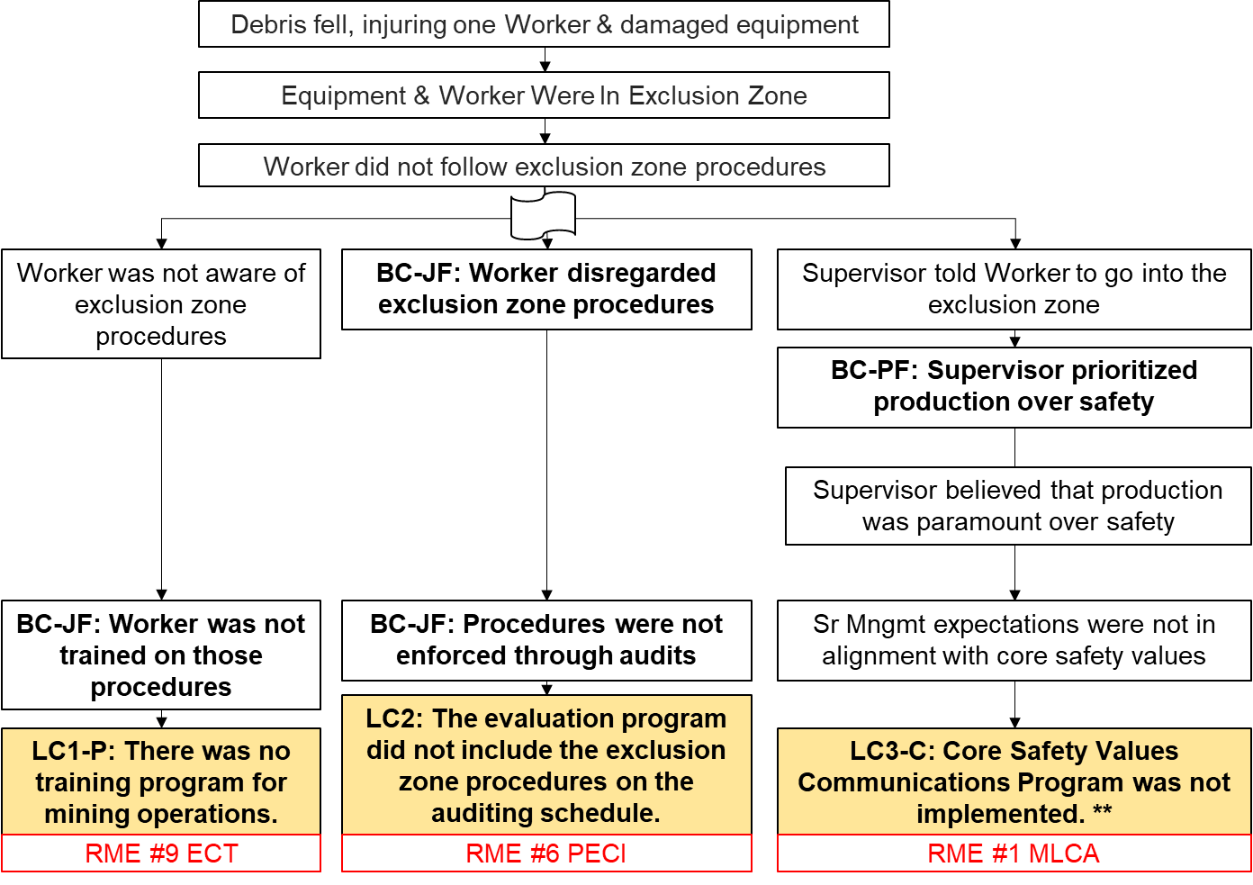
Developing an RCA: Breadth and Depth Illustrated
Breadth and Depth of the Scope of a Root Cause Analysis:
Not deep enough
Depth is right when you discover the LC
Breadth too narrow (3 LC’s)
Breadth about right (18+ LC’s)
Chapter 4.2: C&E Model & Chapter 4.3: RCA of an Incident
22
Notes:
22

Slide 23
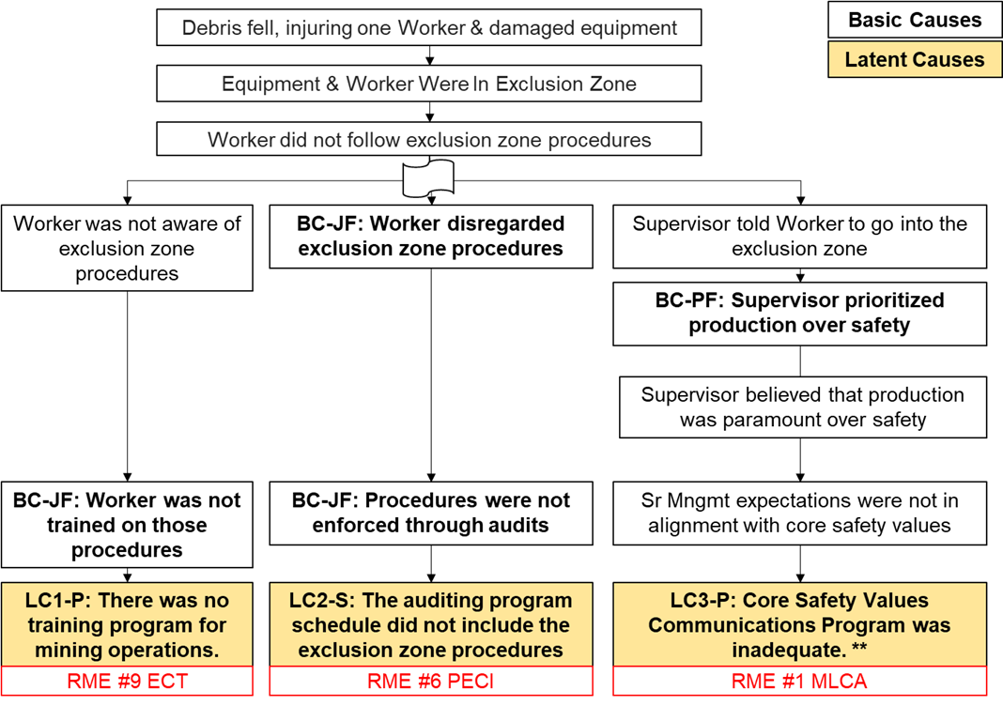
Developing an RCA: Depth Illustrated
Not deep enough
Importance of Depth in a Root Cause Analysis:
Did not drill deep enough. Ask yourself these questions:
Can this cause be linked to an RME in a meaningful and obvious way?
Can a recommendation relating to an RME be made?
Can the cause be categorized as a basic cause? If so, it is NOT a latent cause!
Chapter 4.2: C&E Model & Chapter 4.3: RCA of an Incident
23
Notes:
23

Slide 24
Developing an RCA: Breadth Illustrated
Importance of Breadth in a Root Cause Analysis:
This RCA spanned three (3) risk management system elements.
Are these 3 LCs specific and unique? (A: YES)
Are these 3 LCs through 3 separate roots? (A: YES)
Can other LCs relating to other RMEs be found? (A: YES)
Team Project:
Preliminary RCA Chart – 3 separate roots to 3 unique LCs
Progress Report – at least 18 unique, specific LCs;
feedback provided for improvements
Final Technical Report – a completed RCA Chart with improvements!
Breadth too narrow (3 LC’s)
Chapter 4.2: C&E Model & Chapter 4.3: RCA of an Incident
24
Notes:
24

Slide 25
Root Cause Analysis – Down to Latent Causes:
Drill down through causal analysis to determine latent causes, and
Identify and address weaknesses in the management system elements (the latent causes); this sets the stage for recommendations!
Be able to link a latent cause to a management system element and create a recommendation
Chapter 4.2: C&E Model & Chapter 4.3: RCA of an Incident
25
Notes:
25

Slide 26
ALE #2: Apply The Narrative Technique
Please confer … an opportunity for you to practice the Narrative Technique.
Demonstrates the importance of the narrative technique ie. how to avoid poor logic and logic leaps.
(No MM)
Chapter 4.2: C&E Model & Chapter 4.3: RCA of an Incident
26
Notes:
26

Slide 27
Practice: Apply The Narrative & How to Avoid Logic Leaps
Intermediate causes serve as links between the categories of causes in order to avoid leaps in logic!
Use the narrative technique to uncover logic leaps!
The Worker disregarded the exclusion zone procedures, because
The auditing program schedule did not
include exclusion zone procedures.
Worker disregarded exclusion zone procedures
For this narrative of a root:
“The Worker disregarded the exclusion zone procedures,“
because (or was caused by)
“The auditing program schedule did not include exclusion zone procedures”
Does this statement make sense?
What details are needed to avoid this logic leap?
LC2-S: The evaluation program did not include the exclusion zone procedures on the auditing schedule.
RME #6 PECI
Chapter 4.2: C&E Model & Chapter 4.3: RCA of an Incident
27
Notes:
27

Slide 28
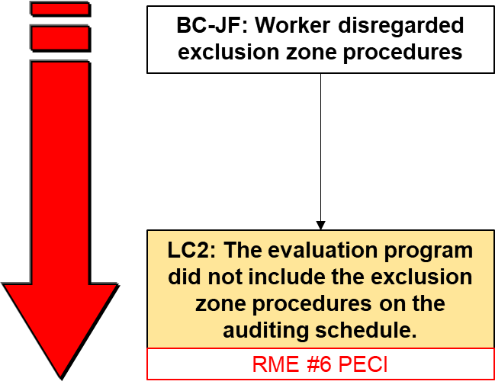
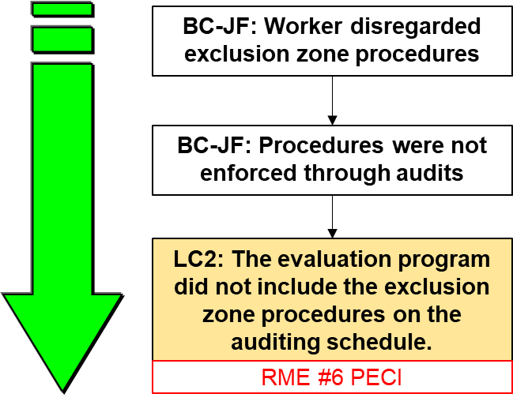
Practice: Apply The Narrative & A Latent Cause
Q: Is this narrative for a root complete, logical,
and does it make sense?
The Worker disregarded the exclusion zone
procedures, because (or was caused by)
The auditing program schedule did not
include exclusion zone procedures
A: [NO]
Q: Is this an improvement?
The Worker disregarded exclusion
zone procedures, because
procedures were not enforced
through audits, because
LC2: The auditing program
schedule did not include the
exclusion zone procedures
A: [YES]
Chapter 4.2: C&E Model & Chapter 4.3: RCA of an Incident
28
Notes:
28

Slide 29
Debris fell, injuring one Worker & damaged equipment
Basic Causes
Latent Causes
The RCA for the “Mine LI” is complete … or is it?
Equipment & Worker Were In Exclusion Zone
Worker did not follow exclusion zone procedures
Worker was not aware of exclusion zone procedures
BC-JF: Worker disregarded exclusion zone procedures
Supervisor told Worker to go into the exclusion zone
BC-PF: Supervisor prioritized production over safety
Supervisor believed that production was paramount over safety
BC-JF: Procedures were not enforced through audits
BC-JF: Worker was not trained on those procedures
Sr Mngmt expectations were not in alignment with core safety values
LC2-S: The evaluation program did not include the exclusion zone procedures on the auditing schedule.
LC1-P: There was no training program for mining operations.
LC3-C: Core Safety Values Communications Program was not implemented. **
RME #9 ECT
RME #6 PECI
RME #1 MLCA
Chapter 4.2: C&E Model & Chapter 4.3: RCA of an Incident
29
Notes:
29

Slide 30
Example: Apply the Narrative & How to Avoid Logic Leaps
The “value” in doing the Root “Narrative”:
(You will practice this in your Prelim. RCA Chart Review Meeting)
Debris fell on equipment, injuring
one Worker & damaged equipment;
Because the Equipment & Worker
Were In Exclusion Zone;
Because the Worker did not follow
exclusion zone procedures;
Because the Worker disregarded
exclusion zone procedures;
Because Procedures were not enforced
through audits;
Because Audits were not done on
the exclusion zone procedures;
Because The evaluation program did not
include the exclusion zone procedures
on the auditing schedule.
Debris fell on equipment, injuring one Worker & damaged equipment
Equipment & Worker Were In Exclusion Zone
Worker did not follow exclusion zone procedures
Worker disregarded exclusion zone procedures
Procedures were not enforced through audits
Improved!
Audits were not done on the exclusion zone procedures.
LC2-S: The evaluation program did not include the exclusion zone procedures on the auditing schedule.
Chapter 4.2: C&E Model & Chapter 4.3: RCA of an Incident
30
Notes:
30

Slide 31
Debris fell, injuring one Worker & damaged equipment
Basic Causes
Latent Causes
Equipment & Worker Were In Exclusion Zone
Now there is very little room for improvement … “Mine LI”!
Worker did not follow exclusion zone procedures
Worker was not aware of exclusion zone procedures
BC-JF: Worker disregarded exclusion zone procedures
Supervisor told Worker to go into the exclusion zone
BC-PF: Supervisor prioritized production over safety
BC-JF: Procedures were not enforced through audits
Supervisor believed that production was paramount over safety
Audits were not done on the exclusion zone procedures.
BC-JF: Worker was not trained on those procedures
Sr Mngmt expectations were not in alignment with core safety values
LC2-S: LC2: The evaluation program did not include the exclusion zone procedures on the auditing schedule.
LC1-P: There was no training program for mining operations.
LC3-C: Core Safety Values Communications Program was not implemented. **
RME #9 ECT
RME #6 PECI
RME #1 MLCA
Chapter 4.2: C&E Model & Chapter 4.3: RCA of an Incident
31
Notes:
31

Slide 32
ALE #3: The Latent Cause Statement
  Please confer on these two questions:
Which is a more appropriate form of a statement for a latent cause?
(Show of hands)
Why? (Open discussion)
  A: Managers did not complete audits on exclusion zone procedures.
  B: The evaluation program did not include the exclusion zone procedures on the auditing schedule.
Chapter 4.2: C&E Model & Chapter 4.3: RCA of an Incident
32
Notes:
32

Slide 33
Best Practices: The Latent Cause Statement, page 1 of 3
Best practices for writing a latent cause statement:
Unique and specific to the root
Relates to one RM element
Expressed in terms relating to:
“P = Inadequate Program”,
“S = Inadequate Program Standards”, or
“C = Inadequate Compliance with Program Standards”
Some fairly simple forms of a statement for a latent cause in this RCA:
[Statement A is unacceptable – this “blames management” AND it is NOT a latent cause statement.]
A: Managers did not complete audits on exclusion zone procedures.
[Statement B is acceptable.]
B: The evaluation program did not include the exclusion zone procedures on the auditing schedule.
Chapter 4.2: C&E Model & Chapter 4.3: RCA of an Incident
33
Notes:
33

Slide 34
Best Practices: The Latent Cause Statement, page 2 of 3
Some great examples of latent cause statement (from a different LI and RCA):
LC1-P: There was no training program for any engineers that were hired by the company. #9EC&T
LC2-S: The incident reporting program did not include reporting criteria (standards) for minor incidents. #5 IRIAA
LC3-S: The MOC program did not include a process or procedure (a standard) to communicate between management and training instructors about changes in training courses and requirements. #4 MOC
LC4-S: The information and documentation program did not include a standard to describe how to manage and access the most current hydraulic standards. #11 OFID
LC5-C: The community awareness program had standards that described the downstream risks of the dam operation but these standards were not communicated to the downstream residents. #3 CA&EP
Chapter 4.2: C&E Model & Chapter 4.3: RCA of an Incident
34
Notes:
34

Slide 35
Best Practices: The Latent Cause Statement, page 3 of 3
What do these great examples of latent cause statement have in common?
They all have these items in common:
Labelled and numbered: LC1, LC2, etc.
Categorized as P, S, or C (The categorization with appropriately stated latent causes demonstrates the ability to differentiate among the three categories of latent causes.)
Each statement has four components, not specifically in this order:
Relates to an element “training”, “design”, “incident reporting”, etc.;
Has the word “program”;
Gives some level or degree of inadequacy that relates to the LC category e.g. inadequate program, inadequate program standards, or inadequate compliance with program standards;
Specific and unique terms or phrases relevant to the root in question.
The stated latent cause then clearly links to a Risk Management System element.
Chapter 4.2: C&E Model & Chapter 4.3: RCA of an Incident
35
Notes:
35

Slide 36
Resources for Best Practices:
“Factors often missed or completed incorrectly for the RCA chart” in the Team Project Instruction Manual
Topic #19 Chapter 4.2: Cause and Effect Model for Incident Analysis and Chapter 4.3: Root Cause Analysis of an Incident - Fundamentals
Topic #20 Chapter 4.2: Cause and Effect Model for Incident Analysis and Chapter 4.3: Root Cause Analysis of an Incident - Latent Causes
Topic #46 Chapter 4.5 Linking Latent Causes to Recommendations for Action
Chapter 4.2: C&E Model & Chapter 4.3: RCA of an Incident
36
Notes:
36

Slide 37
Developing and Validating the Causes:
Once you think you are completed:
Look for any logic leaps or any roots that could benefit with more causation details
Take time to verify by looking for hard evidence for each and every one of your causes.
Note: For your team project, suppositions are acceptable i.e. what are the possible, reasonable, feasible, plausible causes?
Review the evidence and confirm your conclusions with your workplace colleagues. (Team project: check your suppositions with your team-mates; are they possible, reasonable, feasible, plausible?)
This activity validates the actual causes (or plausible causes in the case of your Team Project Loss Incident) and will be very supportive and valuable for determining recommendations and action items.
Chapter 4.2: C&E Model & Chapter 4.3: RCA of an Incident
37
Notes:
37

Slide 38
Summary:
Categories and sub-categories of causes:
Immediate Causes
Basic Causes
Latent Causes
The RCA Work Process is used to create a logical sequence and understanding of incident causation in an RCA Chart.
The Cause and Effect Model is used to categorize causes and to test the depth and breadth of a Root Cause Analysis.
Note on loss incident team project, you will use the available facts AND your engineering know-how and deduction skills to analyze the potential sequences that can lead to the incident in a similar context; apply your skills of rationale and supposition to determine possible, reasonable, feasible, and plausible causes.
Chapter 4.2: C&E Model & Chapter 4.3: RCA of an Incident
38
Notes:
38

Slide 39
Key Lessons:
It is really, really easy to do a root cause analysis … badly.
It takes practice to do a root cause analysis well!
Incidents have causes rooted in management system weaknesses;
these are called latent causes (also sometimes called root causes).
Latent causes can be discovered through a rigourous and disciplined root cause analysis; thus, management can take action on the management system to address the latent causes.
A Latent Cause is synonymous with a weakness a management system element, and can be aligned to any one specific management system element; thus, one can begin to make a recommendation to correct the weakness in the management system, and eliminate the latent cause that can lead to an incident.
Chapter 4.2: C&E Model & Chapter 4.3: RCA of an Incident
39
Notes:
39

Slide 40
Key Lessons:
Must relate the basic causes to the latent causes.
Requires a bit of reverse logic. A trick to use when you are at that level of the analysis:
express each weakness in a RMS element as a failure,
then compare each of these failures with the basic causes.
Each latent cause has a direct link to one, unique management system element that failed.
There is no universal set of latent causes; these must be expressed as weaknesses in the management system elements for the organization.
A well-written, acceptable latent cause statement enables the creation of a recommendation to address that latent cause.
For reporting all causes types, not so important to align causes with the detailed lists; it is important to recognize cause type and in which major group a cause sits.
Chapter 4.2: C&E Model & Chapter 4.3: RCA of an Incident
40
Notes:
40

Slide 41
Any questions?
Notes:
41

